Slide 1
Machine Learning Algorithms
Master in Artificial Intelligence
Luís Ferreira
lufer@ipca.pt

Slide 2
Overview
Part I
Artificial Intelligence and Machine Learning
Foundations
Part II
Machine Learning
Part III
Machine Learning Algorithms
Parte V
Deep Learning & Neural Networks
Parte IV
Advanced ML

Slide 3
Part IV
Machine Learning Algorithms
Competencies to be acquired:
Deploying ML Models

Slide 4
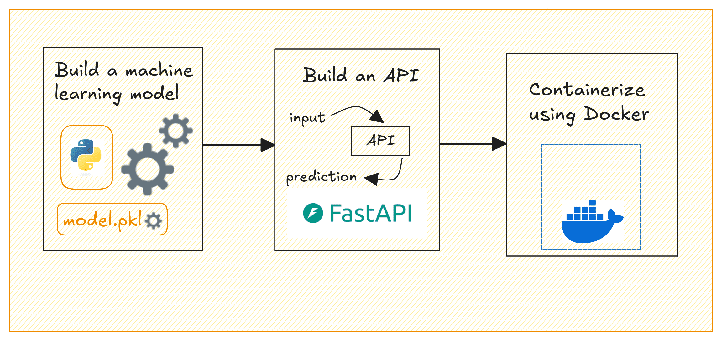
Part IV
Deploying MLA
Competencies to be acquired:
Deploying ML Models
Notes:
https://machinelearningmastery.com/a-practical-guide-to-deploying-machine-learning-models/

Slide 5
Part IV
Deploying MLA
Steps
Export the model from Google Colab.
    !pip install pickle (or joblib )
    pickle.dump(model, "model.pkl") (or joblib.dump(model, "model.pkl"))
Create a web service to make predictions (Flask; FastAPI, etc.)
Deploy the web service using Docker, Heroku, AWS Elastic Beanstalk, Kubernets, etc.
Integrate the web service with your website…html files for testing!

Slide 6
Part IV
Deploying MLA
The Approach:
Model building:
  12-Deploy.ipynb
Model exported
  linearRegressionModel.pkl
FastAPI Endpoints
Docker for deploying web services
Html|Flask files for testing! Postman to test too!

Slide 7
Part IV
Deploying MLA
Create a Python Virtual Environment
  python -m venv v1 #create v1 virtual environment
  v1\scripts\activate #activate the venv #deactivate
Install the required packages
  pip3 install pandas scikit-learn fastapi uvicorn
Create the FastAPI App
  server.py
Create the docker container
  requitements.txt
  Dockerfile
Use the model API
  curl | Postman | Html

Slide 8
Part IV
Deploying MLA
# app/server.py
#...
# Define the input data schema
class InputData(BaseModel):
MedInc: float
AveRooms: float
AveOccup: float
# Initialize FastAPI app
app = FastAPI(title="House Price Prediction API - MIAA")
# Load the model during startup
model_path = os.path.join("model", "linearRegressionModel.pkl")
with open(model_path, 'rb') as f:
model = pickle.load(f)
# Define endpoint
@app.post("/predict")
def predict(data: InputData):
input_features = [[data.MedInc, data.AveRooms, data.AveOccup]]
prediction = model.predict(input_features)
return {"predicted_house_price": prediction[0]}
FastAPI
endpoints

Slide 9
Part IV
Deploying MLA
uvicorn: ASGI (Asynchronous Server Gateway Interface)
FROM python:3.11-slim
# Set the working directory inside the container
WORKDIR /code
# Copy the requirements file
COPY ./requirements.txt /code/requirements.txt
# Install the Python dependencies
RUN pip install --no-cache-dir --upgrade -r /code/requirements.txt
# Copy the app folder into the container
COPY ./app /code/app
# Copy the model directory (with the saved model file) into the container
COPY ./model /code/model
# Expose port 8000 for FastAPI
EXPOSE 8000
# Command to run the FastAPI app with Uvicorn
CMD ["uvicorn", "app.server:app", "--host", "0.0.0.0", "--port", "8000"]
Dockerfile

Slide 10
Part IV
Deploying MLA
Docker requirements
fastapi
uvicorn
scikit-learn
pandas

Slide 11
Part IV
Deploying MLA
Note: Check if docker is running
  docker info
  if not, start “Docker Desktop start”
4. Build the Docker image
Build and run the Docker container
docker build -t prediction-api .
docker run -d --name miaa-test -p 8000:8000 prediction-api
goDocker.bat
docker build -t prediction-api .
docker run -d --name miaa-fastapi -p 8000:8000 prediction-api

Slide 12
Part IV
Deploying MLA
Use the API with curl
http://127.0.0.1:8000/predict
Json input data (input.json):
{
"MedInc": "3.5",
"AveRooms": "5.0",
"AveOccup": "2.0"
}
curl -X POST -H "Content-Type: application/json" -d @input.json http://localhost:8000/predict

Slide 13
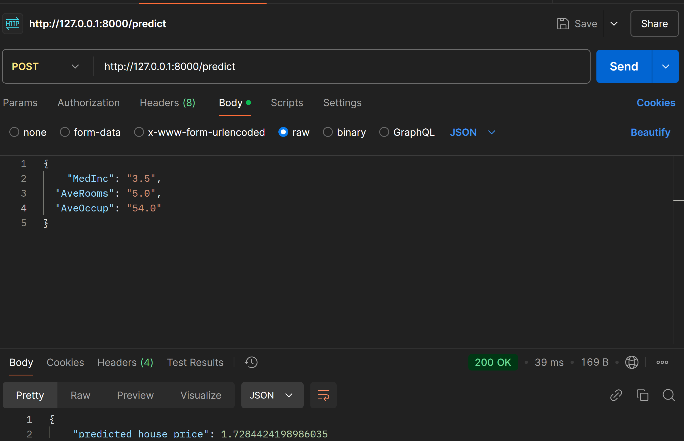
Part IV
Deploying MLA
Use the API with Postman
POST; http://127.0.0.1:8000/predict
Body + raw:
{
"MedInc": "3.5",
"AveRooms": "5.0",
"AveOccup": "2.0"
}
With Postman

Slide 14
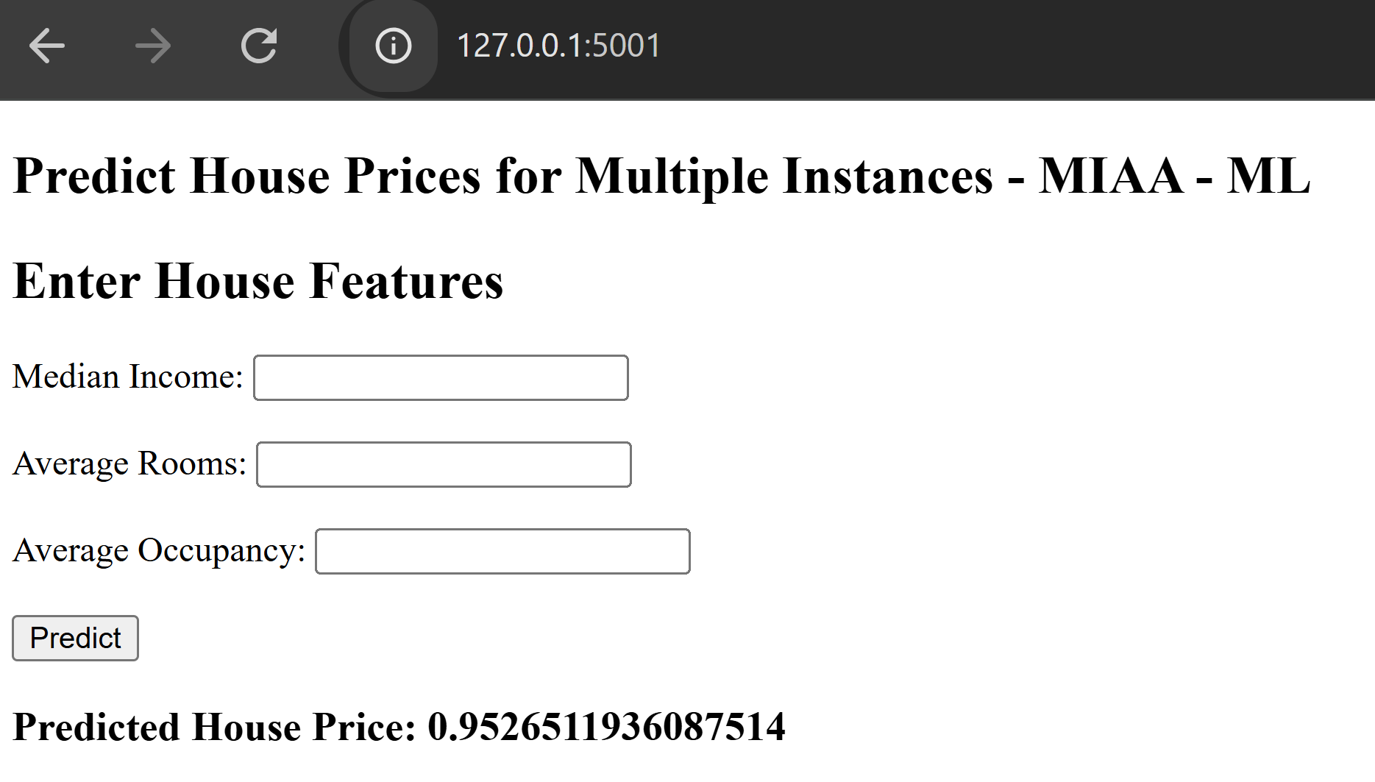
Part IV
Deploying MLA
Use the API with Flask + HTML
  Files:
  webtest.py
  index.html
  Steps:
  pip install flask
  pip install requests
  python webtest.py
  http:// 127.0.0.1:5001

Slide 15
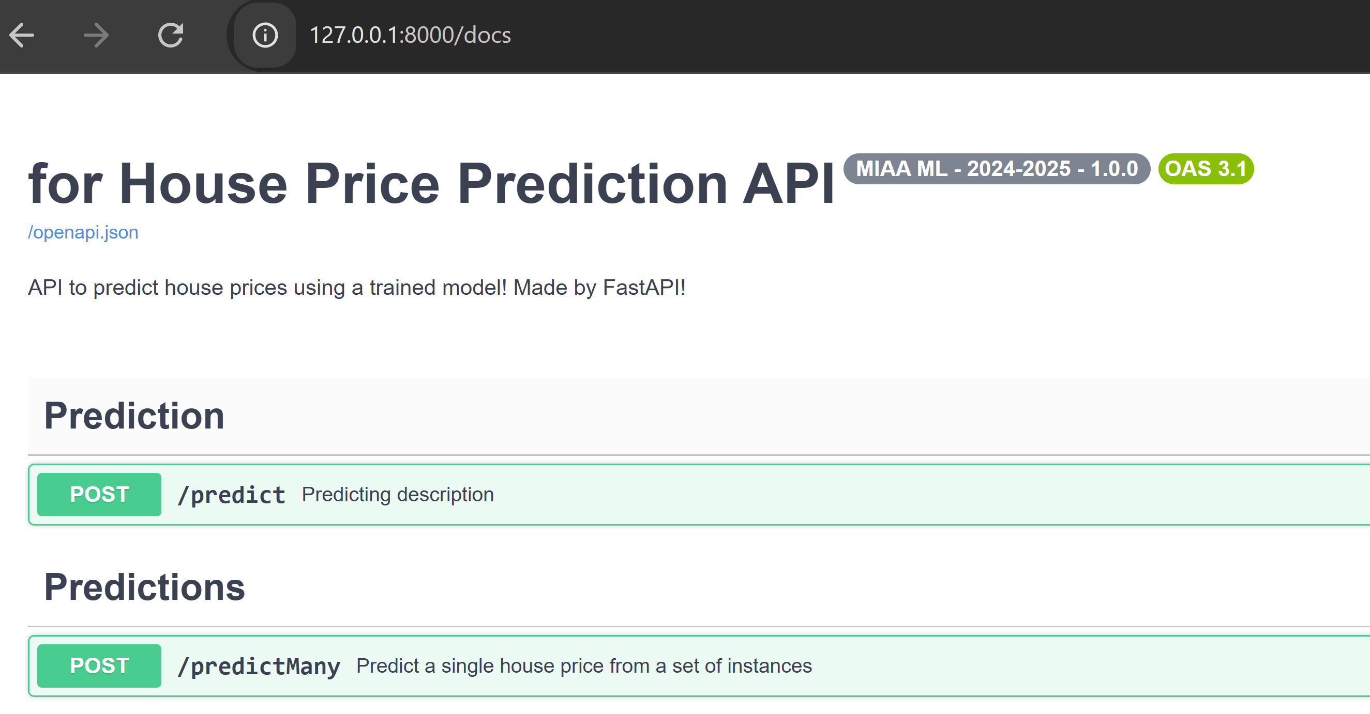
Part IV
Deploying MLA
Explore the API
documentation
with Swagger
http://127.0.0.1:8000/docs

Slide 16
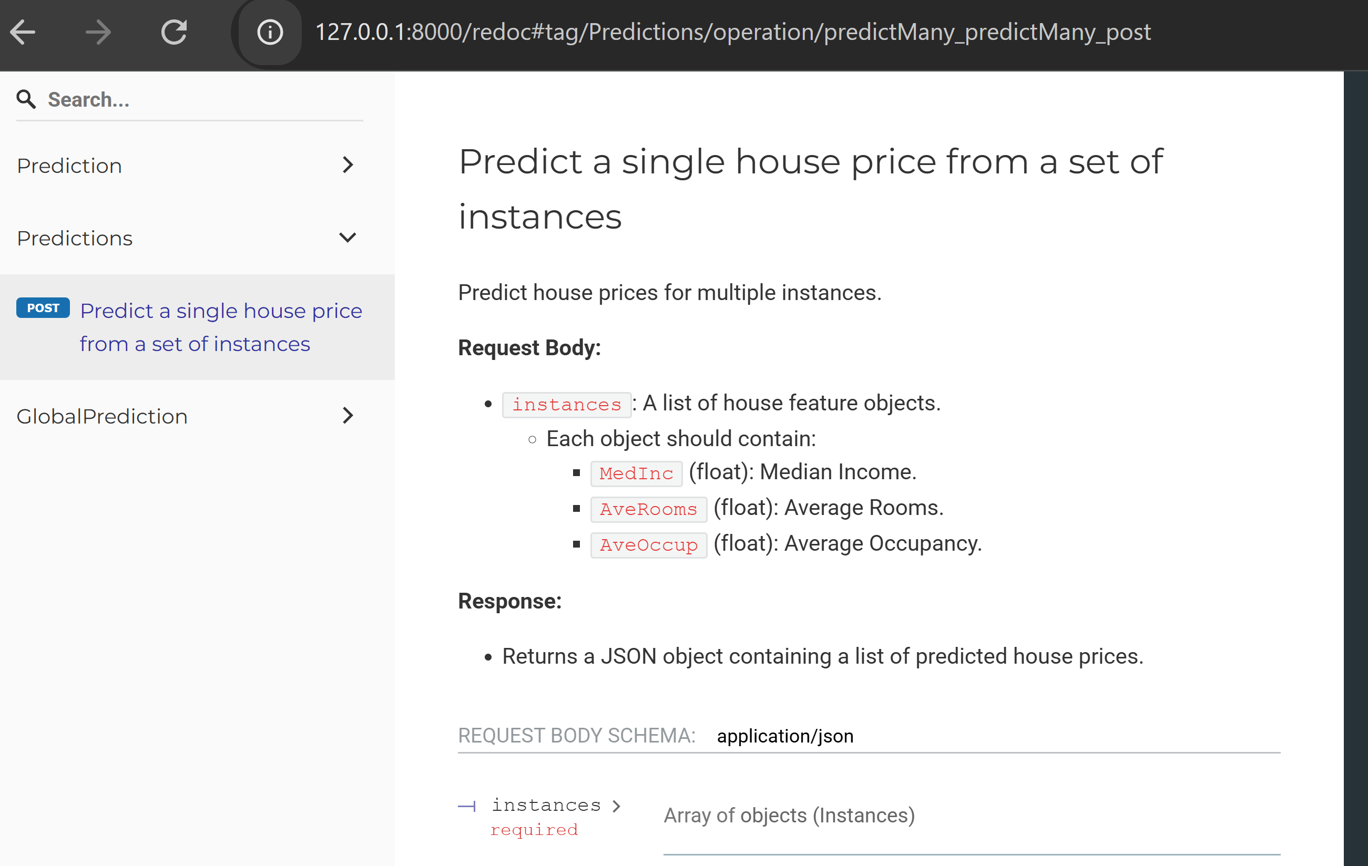
Part IV
Deploying MLA
Explore the API
documentation
with Redoc
http://127.0.0.1:8000/redoc

Slide 17
Part IV
Deploying MLA
The final Project folder:
── Dockerfile
── requirements.txt
── app/
└── server.py
── model/
└── linearRegressionModel.pkl
── others

Slide 18
Part IV
Deploying MLA
Sharing the Model: Tag and Push the Docker Image to Docker Hub
login to Docker Hub:
docker login
Tag the Docker image:
docker tag prediction-api lufer2025/prediction-api:v1
Push the image to Docker Hub
docker push lufer2025/prediction-api:v1
Other developers can pull and run the image:
    docker pull lufer2025/prediction-api:v1
    docker run -d -p 80:80 lufer2025/price-prediction-api:v1

Slide 19
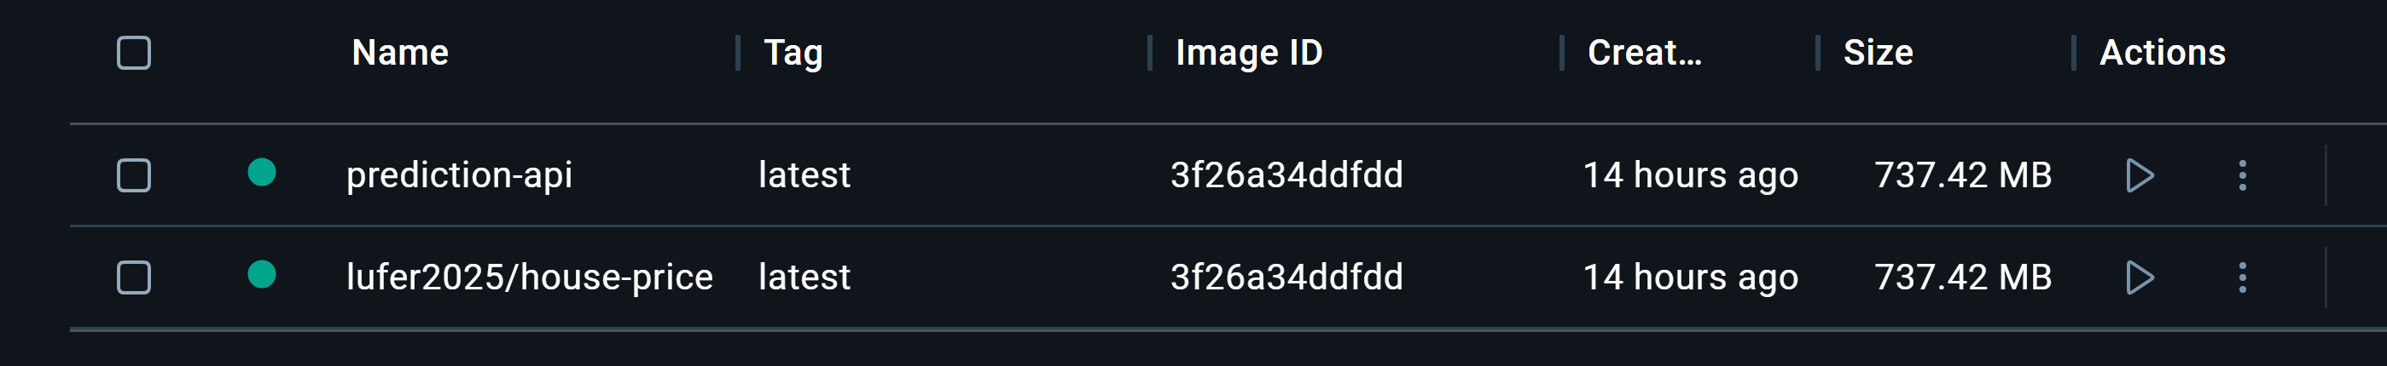
Part IV
Deploying MLA
Tag and Push the Docker Image to Docker Hub (share model)
login to Docker Hub:
docker login
Tag the Docker image:
docker tag prediction-api lufer2025/prediction-api:v1
Push the image to Docker Hub
docker push lufer2025/prediction-api:v1
Other developers can pull and run the image:
    docker pull lufer2025/prediction-api:v1
    docker run -d -p 80:80 lufer2025/price-prediction-api:v1
Docker Desktop

Slide 20
Part IV - AI&ML
Deploying MLA
In-depth Guide to Machine Learning (ML) Model Deployment
  https://shelf.io/blog/machine-learning-deployment/
Easily deploy machine learning models from the comfort of your Notebook
  https://moez-62905.medium.com/easily-deploy-machine-learning-models-from-the-comfort-of-your-notebook-9068a88f4cf5
Docker containers
  https://docker-curriculum.com/
The Best API Documentation Tools for Dev Teams
  https://bump.sh/blog/the-best-api-documentation-tools-for-dev-teams

Slide 21
Progress
Part I
Artificial Intelligence and Machine Learning
Foundations
Part II
Machine Learning
Part III
Machine Learning Algorithms
Part IV
Deep Learning & Neural Networks
Part V
Parte V
Building ML Model

Slide 22
References
Machine Learning. Tom M. Mitchel, McGraw-Hill, 1997
Machine Learning for Everyone
  https://vas3k.com/blog/machine_learning/
Machine Learning Tutorial
  https://www.simplilearn.com/tutorials/machine-learning-tutorial/machine-learning-steps
What is machine learning and how does it work? In-depth guide
  https://www.techtarget.com/searchenterpriseai/definition/machine-learning-ML

Slide 23
References
Google Colab
  https://colab.research.google.com/
Examples of Machine Learning Projects
  https://www.datacamp.com/blog/machine-learning-projects-for-all-levels
Elements of AI (free online course)
  https://www.elementsofai.com/

Slide 24
References

Slide 25
Appendices

